Slide 1
Design Phase — UML Diagrams
A Smart Device for Visually Impaired Individuals to Transform Images into Speech
B.Tech CSE Mini Project
INDUSTRY ORIENTED MINI PROJECT (2026-2027), DEPARTMENT OF CSE - Anurag University

Slide 2
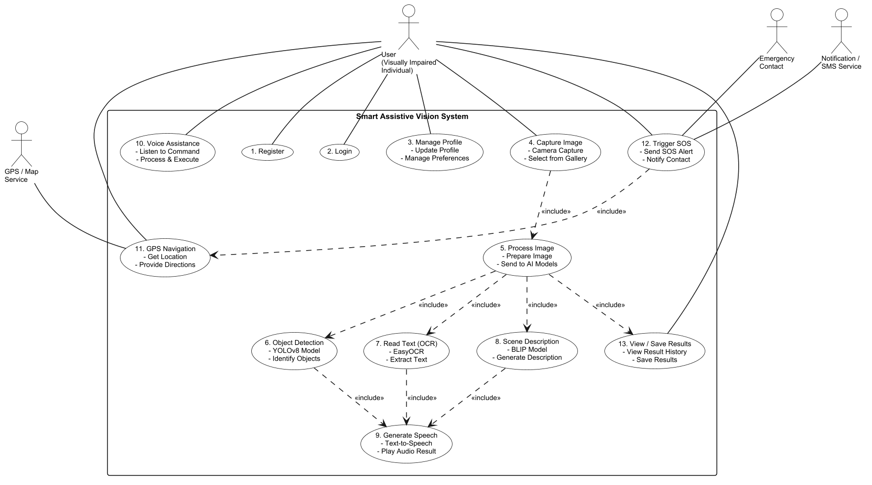
UML Diagram – Use Case Diagram
INDUSTRY ORIENTED MINI PROJECT (2026-2027), DEPARTMENT OF CSE - Anurag University
1

Slide 3
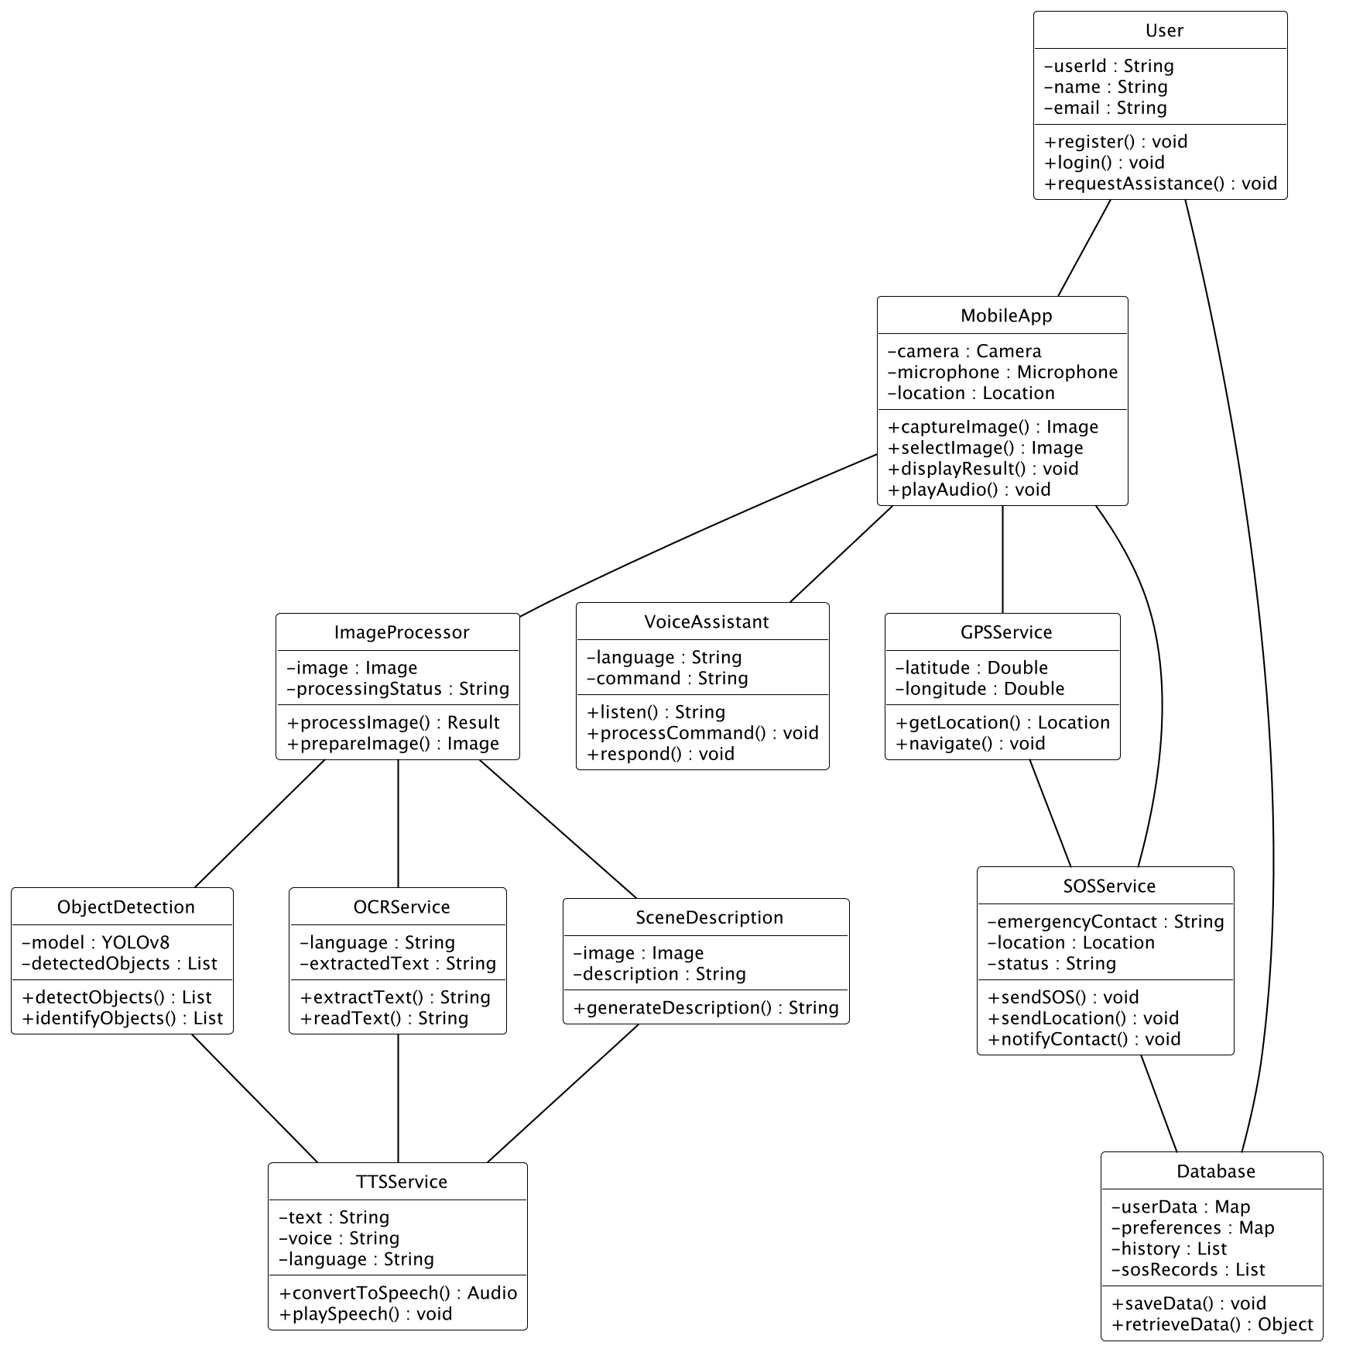
UML Diagram – Class Diagram
INDUSTRY ORIENTED MINI PROJECT (2026-2027), DEPARTMENT OF CSE - Anurag University
2

Slide 4
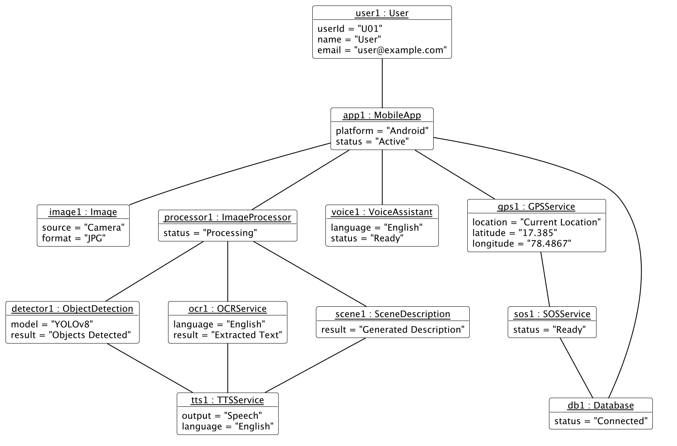
UML Diagram – Object Diagram
INDUSTRY ORIENTED MINI PROJECT (2026-2027), DEPARTMENT OF CSE - Anurag University
3

Slide 5
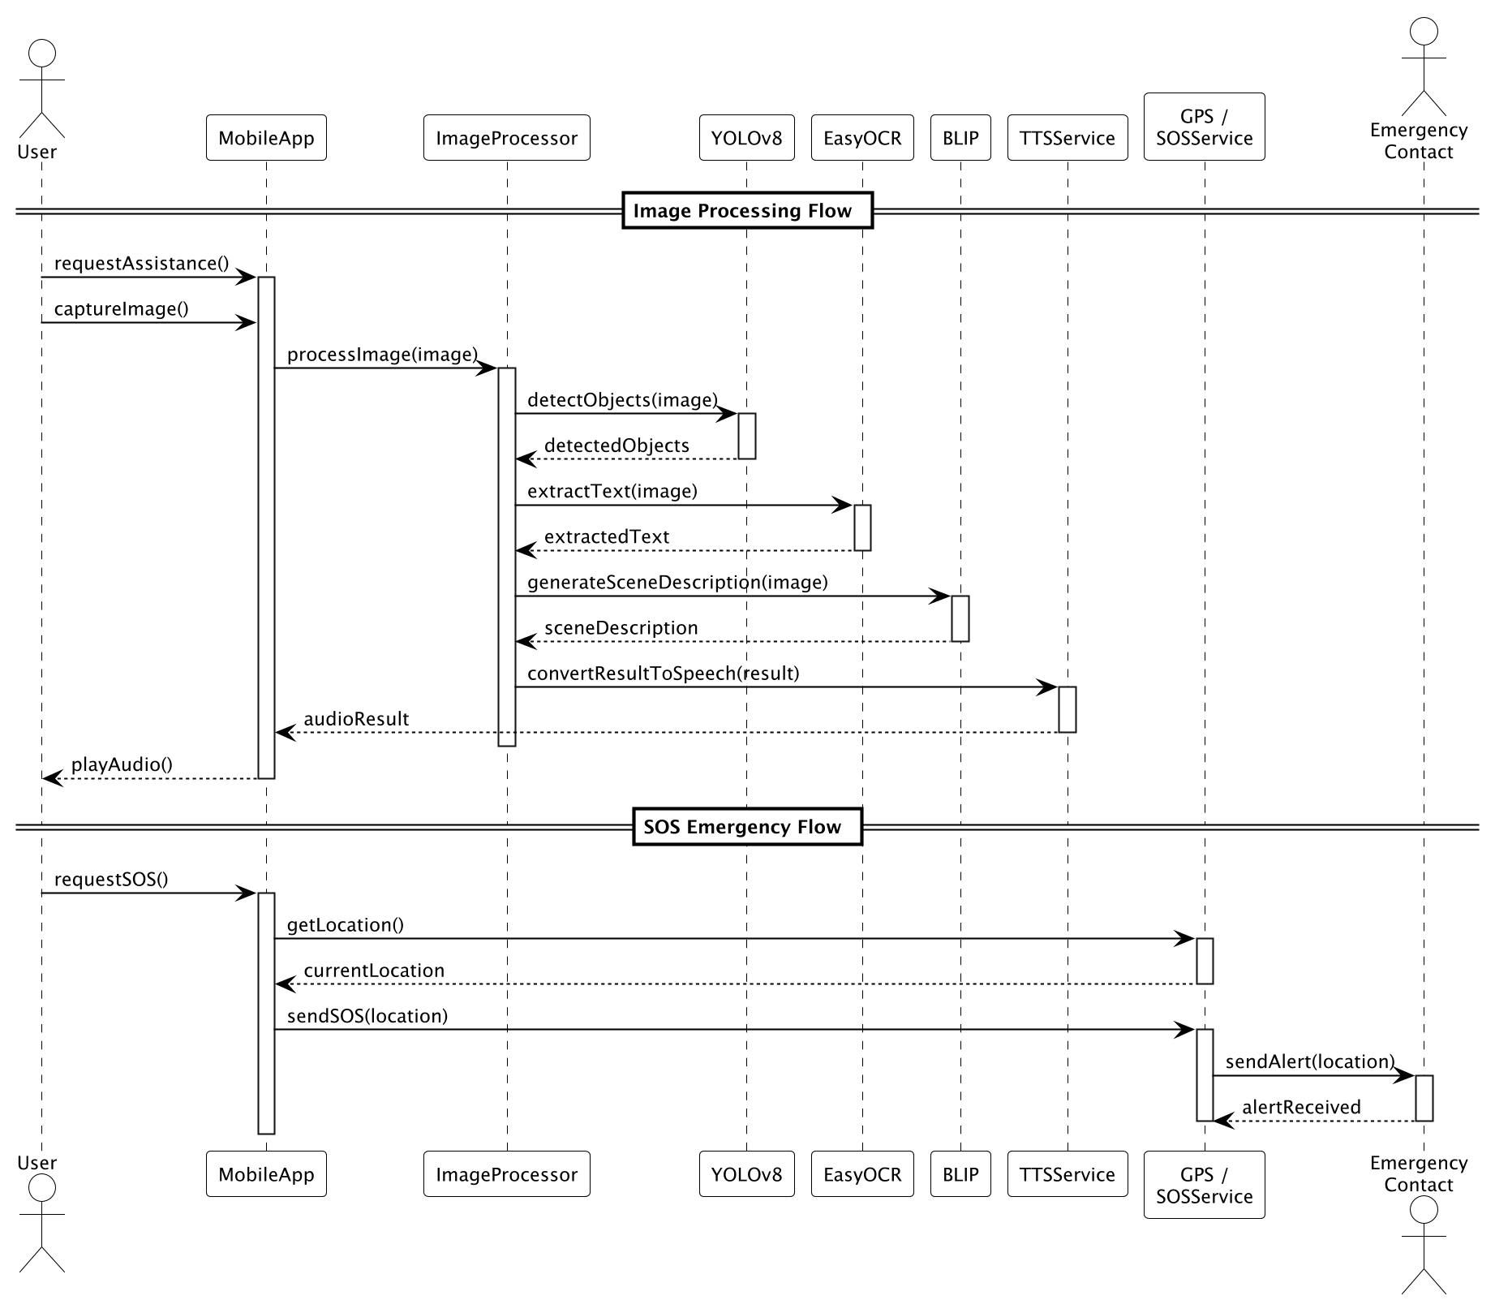
UML Diagram – Sequence Diagram
INDUSTRY ORIENTED MINI PROJECT (2026-2027), DEPARTMENT OF CSE - Anurag University
4

Slide 6
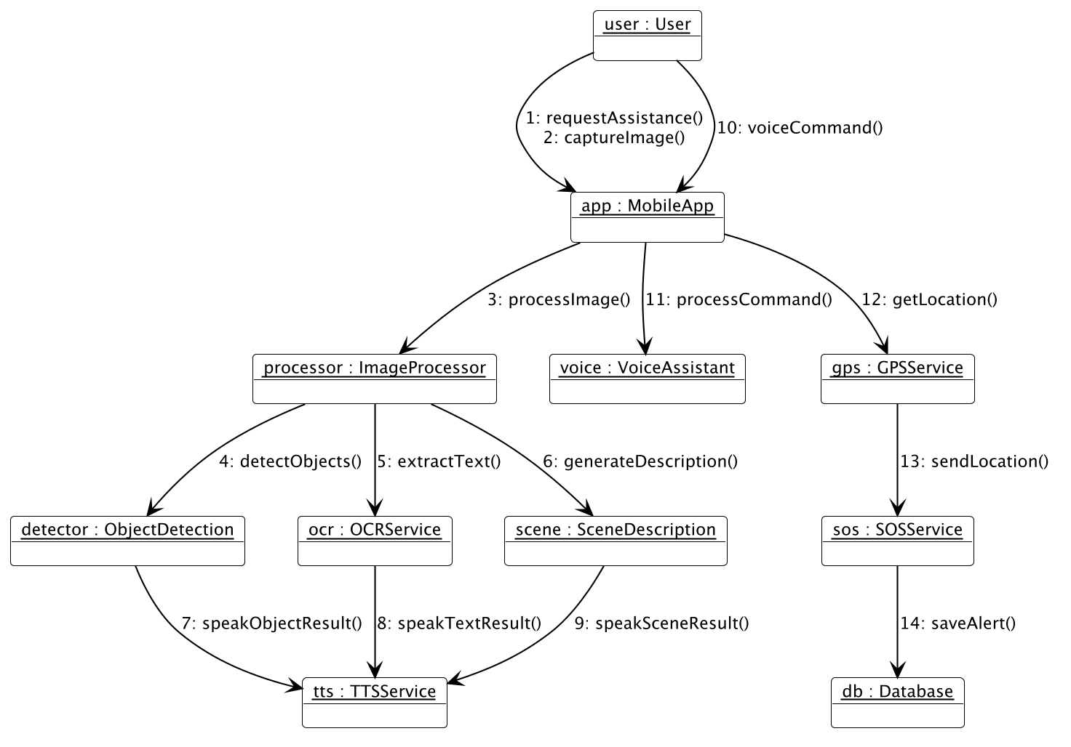
UML Diagram – Communication Diagram
INDUSTRY ORIENTED MINI PROJECT (2026-2027), DEPARTMENT OF CSE - Anurag University
5

Slide 7
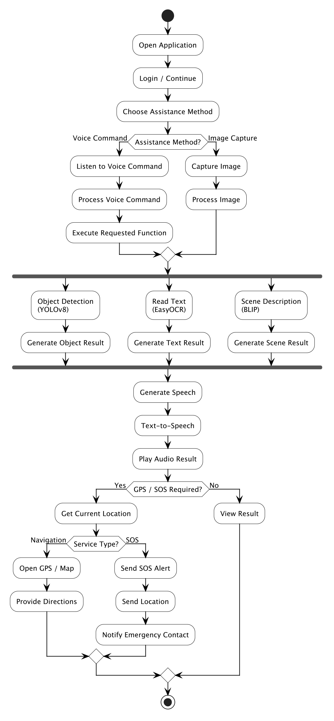
UML Diagram – Activity Diagram
INDUSTRY ORIENTED MINI PROJECT (2026-2027), DEPARTMENT OF CSE - Anurag University
6

Slide 8
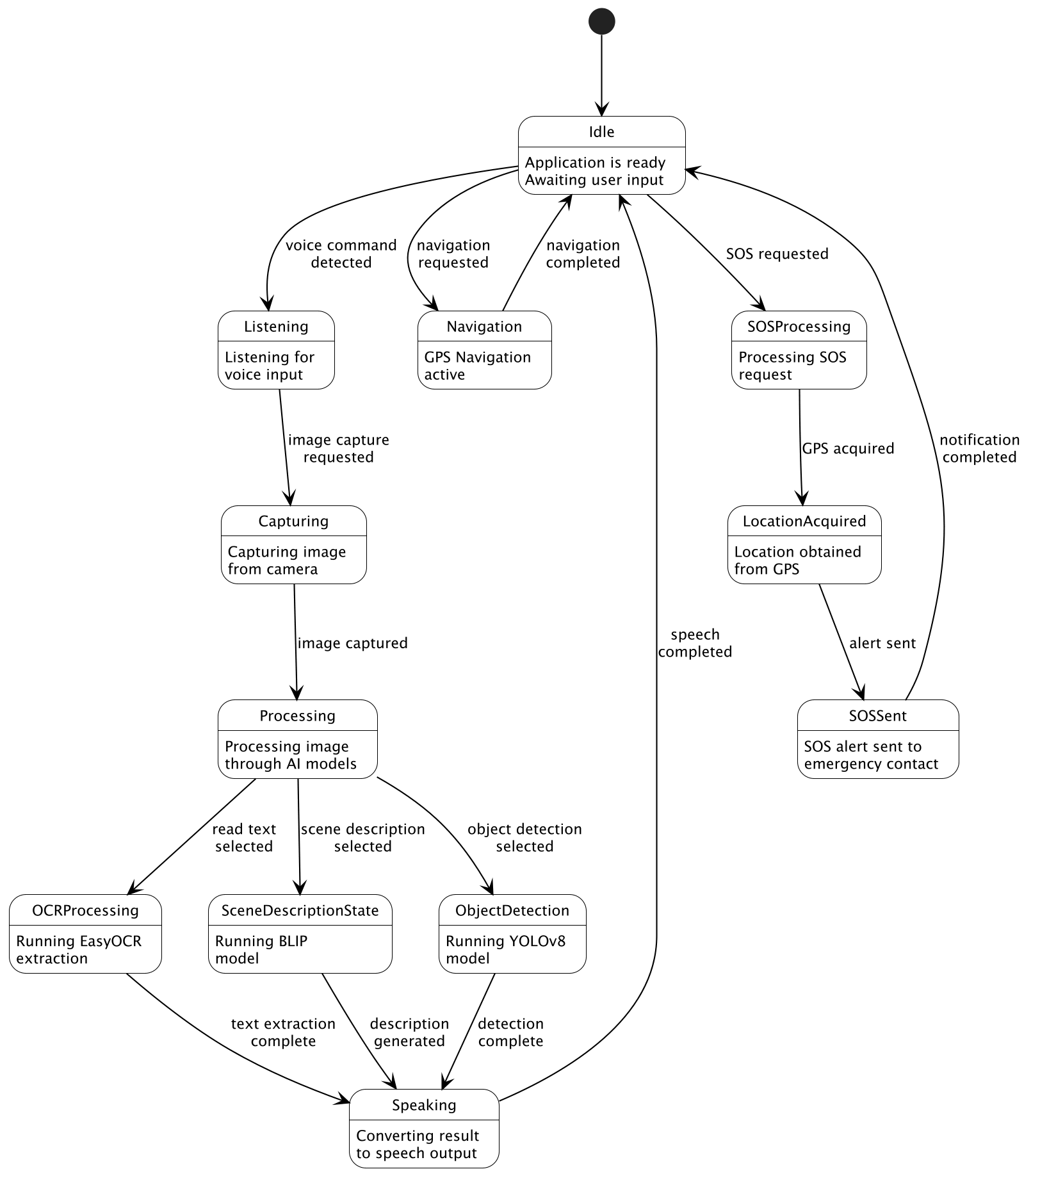
UML Diagram – State Machine Diagram
INDUSTRY ORIENTED MINI PROJECT (2026-2027), DEPARTMENT OF CSE - Anurag University
7

Slide 9
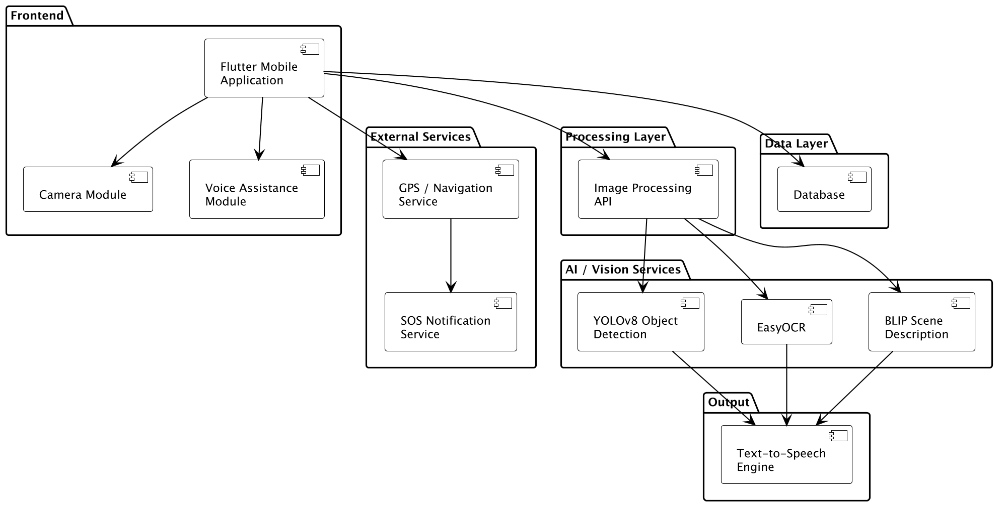
UML Diagram – Component Diagram
INDUSTRY ORIENTED MINI PROJECT (2026-2027), DEPARTMENT OF CSE - Anurag University
8

Slide 10
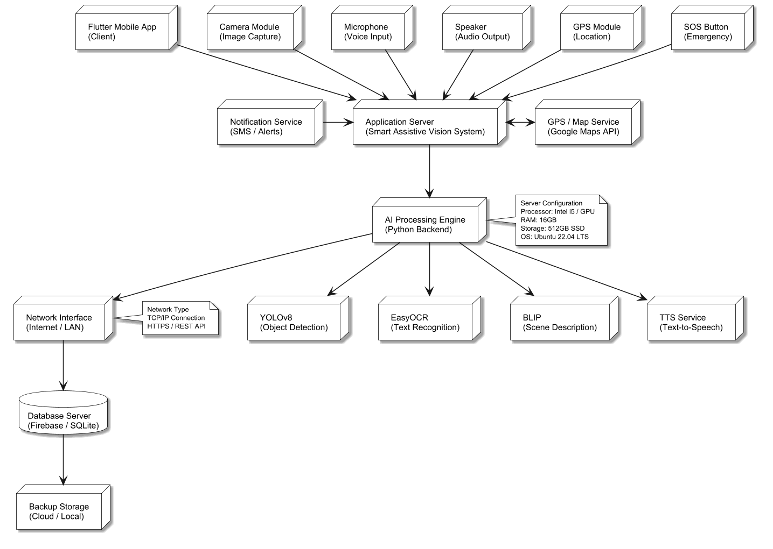
UML Diagram – Deployment Diagram
INDUSTRY ORIENTED MINI PROJECT (2026-2027), DEPARTMENT OF CSE - Anurag University
9

